Slide 1
Struktura e HTML

Slide 2
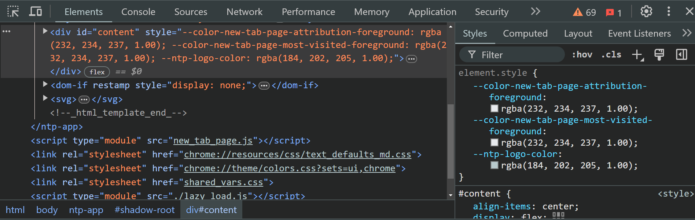
Developer Tools

Slide 3
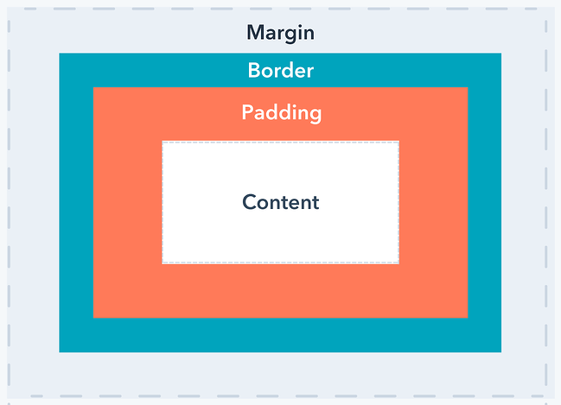
Padding vs Margin

Slide 4
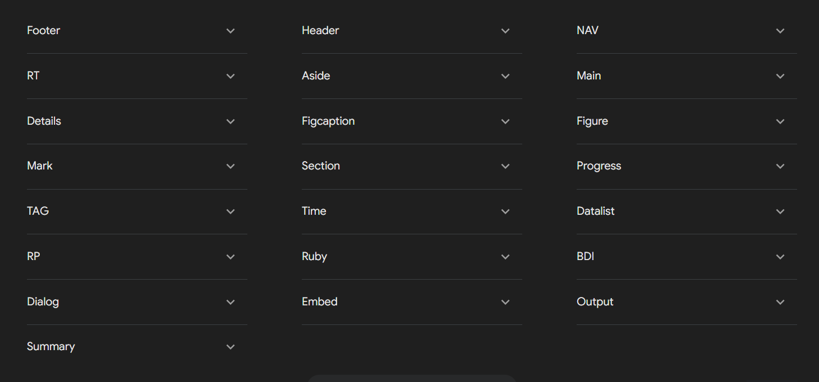
Elementet e ri ne html

Slide 5
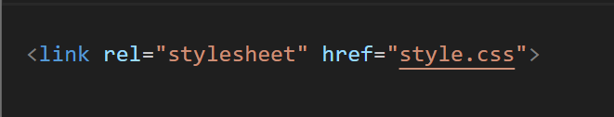
CSS File

